Slide 1
Smart Charger Case
1-wire UART HW design notice
V1.5
2021/01/21

Slide 2
Histories
Version | Descriptions | Date
V1.0 | Initial Version | 2020/03/18
V1.1 | Add Smart Charger Case Command for Earbuds Battery Level Remove Smart Charger Case Command for Charger State Add Item 6~8 in Charger case design Guidance Modify delay time of open lid AB156X=>400ms | 2020/05/28
V1.2 | Modify Charger case Recommend Block diagram Modify “Open-lid command sending delay requirement” for AB156x | 2020/06/17
V1.3 | Add notice of Vg voltage for AB155x/AB1568 (P.5) Add notice of baud rate HW limitation for AB1562/AB1565 (P.6) | 2020/11/27
V1.4 | Add Charger case timing limitation | 2020/12/07
V1.5 | Add Nmos part number for reference | 2021/01/21
Confidential B

Slide 3
Outline
Recommend Block diagram
rBOM – Charging case/Earbud
Operating in CHG/COM mode
3rd party MCU min. HW requirement

Slide 4
Recommend Block diagram
- Smart Charging Case
Smart Charging case
Load Switch
Option for RESET Earbuds
w/ Discharge function
On/Off by MCU control
Test point x2 (VBUS_UART, GND)
MODE select
＋
Charger
Boost
5V
VBUS_UART pattern
100k
Q1
5.1k
－
L: COM mode
H: CHG mode
Power
Enable
5.1k
GPIO
GPIO
Q2b
MCU
Q2a
VBAT
UART TX
EINT
UART RX
Level shift
ADC
ADC
＋
Q3a
Q3b
－
Case switch
Interrupt
Current Sense
Current Sense
Confidential B

Slide 5
Recommend Block diagram
- Earbuds (AB155x/AB1568)
Earbud
AB155x only
AB155x
/AB1568
499k
100k
ADC
Mode select
＋
VBUS
Q1
100k
1uF
－
Q2a
GPIO
Q2b Vg must same as VIO of UART1 TX/RX
Level shift
VIO18
UART1_ TX
Q2b
UART1_ RX
MCU
Option RST solution
Detect VBUS pattern
SYSRSTB
AB155x only
Confidential B

Slide 6
Recommend Block diagram
- Earbuds (AB1562/AB1565)
Earbud
AB1562
/AB1565
VBUS_UART
Integrate in AB1562/AB1565
＋
VBUS
1uF
If UART1 TX/RX voltage level is not 1.8V, the max baud rate recommend DO NOT over 35Kbps
－
UART_TRX
UART1_ TX
UART1_ RX
MCU
Option RST solution
Detect VBUS pattern
SYSRSTB
Confidential B

Slide 7
rBOM - Charging case
item | Part reference | Ref price (USD)
MCU | MS51XB9BE Flash: 16KB / SRAM: 1KB | $0.16
Charger + Boost | ETA96gTE8A | $0.17
Q1 | Single P-MOS DMP21D0UFB4-7B | $0.0205
Q2, Q3 | Dual N-MOS NTUD3170NZ DMN2990UDJ | $0.045
Load switch (Option for reset) | Load switch NCP333 | $0.05

Slide 8
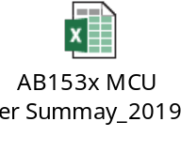
rBOM - Earbud
item | Part reference | Ref price (USD)
MCU (Option for reset) | Ref. MCU selection guide

Slide 9
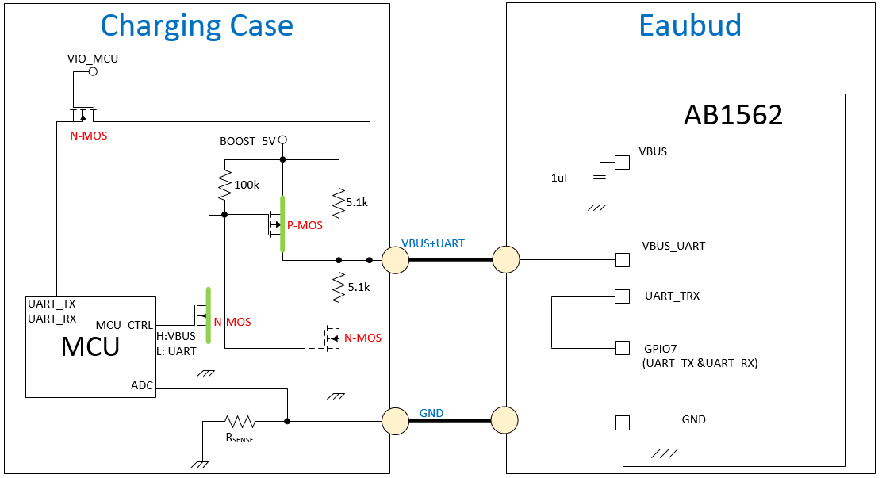
Charger mode

Slide 10
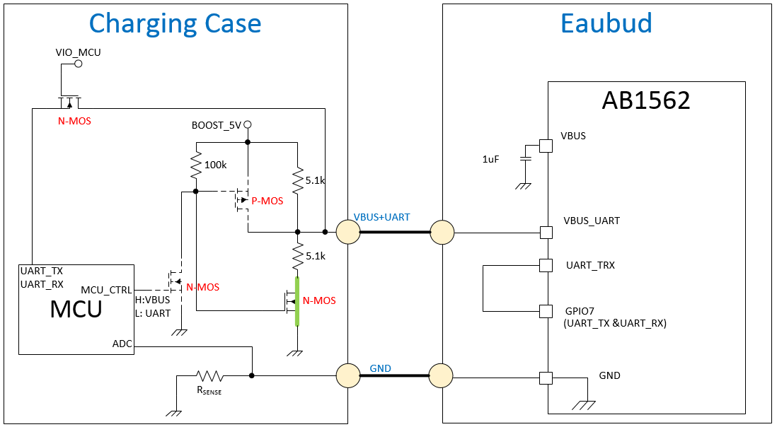
Com mode

Slide 11
Operating in CHG/COM mode
CHG
mode
COM mode
MCU_VIO: VBAT
MCU_UART
TX
RX
MCU_VIO: VBAT
Charging case
Send command
Charging case
Receive response
MCU_CTRL
0V
5V
2.5V
VBUS_UART
1.8V
1562_GPIO7
RX
TX

Slide 12
3rd party MCU
Min. HW requirement
ADC
  2 for Earbuds current sense: accuracy at least 4mA
  1 for Battery voltage sense: accuracy at least 50mV
  1 for Battery current sense (Option)
EINT
  1 for Hall sensor
  1 for KEY (Option)
GPIO
  1 for Boost enable/disable
  1 for CHG/COM mode select
  1 for RESET earbud by VBUS_UART pattern (Option)
UART
  1 for VBUS_TRX: Baud rate at least 115200
  1 for Debug (Option)
Timer
  Timer clock >1Mhz, at least 20ms interval interrupt

Slide 13
Vendor contact window
MCU
  Nuvoton sales, HFLiu@nuvoton.com
  Nuvoton marketing, YCWANG@nuvoton.com
  Nuvoton FAE, TCChiu1@nuvoton.com
MOSFET
  DII Sales, alvin_tsai@tw.diodes.com
Charger + Boost
  ETA sales, eric@etasolution.com

Slide 14
One-Wire UART
Smart Charger Case
SW design

Slide 15
Smart Charger Case Spec (1/13)
Smart Charger Case Command Format:
Smart Charger Case Response Format:
Header | Type | Length | ID | Command
0x05 | 0x5A | N | 0x2000 | Payload
Header | Type | Length | ID | Response
0x05 | 0x5B | N | 0x2000 | Payload

Slide 16
Smart Charger Case Spec (2/13)
Smart Charger Case Command: Open Lid
Header | Type | Length | ID | Command
0x05 | 0x5A | 5 | 0x2000 | SCC (Smart Charger Case) CMD ID (1 byte) 0x02: OPEN_LID. Earbud ID (1 byte) 0: To left earbud. 1: To right earbud. Charger case battery level report (1 byte) 0 ~ 100: Battery voltage percentage (%). Others: Reserved.

Slide 17
Smart Charger Case Spec (3/13)
Smart Charger Case Response: Open Lid
Header | Type | Length | ID | Response
0x05 | 0x5B | 5 | 0x2000 | SCC (Smart Charger Case) CMD ID (1 byte) 0x02: OPEN_LID. Earbud ID (1 byte) 0: From left earbud. 1: From right earbud. Earbuds battery level report (1 byte) 0 ~ 100: Battery voltage percentage (%). 0xFF: Fail. Others: Reserved.

Slide 18
Smart Charger Case Spec (4/13)
Smart Charger Case Command: Close Lid
Header | Type | Length | ID | Command
0x05 | 0x5A | 4 | 0x2000 | SCC (Smart Charger Case) CMD ID (1 byte) 0x03: CLOSE_LID. Earbud ID (1 byte) 0: To left earbud. 1: To right earbud.

Slide 19
Smart Charger Case Spec (5/13)
Smart Charger Case Response: Close Lid
Header | Type | Length | ID | Response
0x05 | 0x5B | 5 | 0x2000 | SCC (Smart Charger Case) CMD ID (1 byte) 0x03: CLOSE_LID. Earbud ID (1 byte) 0: From left earbud. 1: From right earbud. Earbuds battery level report (1 byte) 0 ~ 100: Battery voltage percentage (%). 0xFF: Fail. Others: Reserved.

Slide 20
Smart Charger Case Spec (6/13)
Smart Charger Case Command: Charger Off
Note: Charge full or case low bat.
Header | Type | Length | ID | Command
0x05 | 0x5A | 5 | 0x2000 | SCC (Smart Charger Case) CMD ID (1 byte) 0x04: CHARGER_OFF. Earbud ID (1 byte) 0: To left earbud. 1: To right earbud. Charger case battery level report (1 byte) 0 ~ 100: Battery voltage percentage (%). Others: Reserved.

Slide 21
Smart Charger Case Spec (7/13)
Smart Charger Case Response: Charger Off
Header | Type | Length | ID | Response
0x05 | 0x5B | 5 | 0x2000 | SCC (Smart Charger Case) CMD ID (1 byte) 0x04: CHARGER_OFF. Earbud ID (1 byte) 0: From left earbud. 1: From right earbud. Earbuds battery level report (1 byte) 0 ~ 100: Battery voltage percentage (%). 0xFF: Fail. Others: Reserved.

Slide 22
Smart Charger Case Spec (8/13)
Smart Charger Case Command: Key
Note: Charger case key customization, ex:
0: long press 3 second to disconnect w/ handset.
1: long press 10 second to clear pairing data w/ handset.
Header | Type | Length | ID | Command
0x05 | 0x5A | 5 | 0x2000 | SCC (Smart Charger Case) CMD ID (1 byte) 0x05: CHARGER_KEY. Earbud ID (1 byte) 0: To left earbud. 1: To right earbud. Key Event (1 byte) 0: Key event 0 is triggered. 1: Key event 1 is triggered. ..... 255: Key event 255 is triggered.
Notes:
Note: 充電倉按鍵行為. 客製化定義, 例如:
0: long press 3 second to disconnect w/ handset.
1: long press 10 second to clear pairing data w/ handset.

Slide 23
Smart Charger Case Spec (9/13)
Smart Charger Case Response: Key
Header | Type | Length | ID | Response
0x05 | 0x5B | 5 | 0x2000 | SCC (Smart Charger Case) CMD ID (1 byte) 0x05: CHARGER_KEY. Earbud ID (1 byte) 0: From left earbud. 1: From right earbud. Earbuds battery level report (1 byte) 0 ~ 100: Battery voltage percentage (%). 0xFF: Fail. Others: Reserved.

Slide 24
Smart Charger Case Spec (10/13)
Smart Charger Case Command: Earbuds Battery Level
Header | Type | Length | ID | Command
0x05 | 0x5A | 4 | 0x2000 | SCC (Smart Charger Case) CMD ID (1 byte) 0x06: BATTERY_LEVEL Earbud ID (1 byte) 0: To left earbud. 1: To right earbud.

Slide 25
Smart Charger Case Spec (11/13)
Smart Charger Case Response: Earbuds Battery Level
Header | Type | Length | ID | Response
0x05 | 0x5B | 5 | 0x2000 | SCC (Smart Charger Case) CMD ID (1 byte) 0x06: BATTERY_LEVEL Earbud ID (1 byte) 0: From left earbud. 1: From right earbud. Earbuds battery level report (1 byte) 0 ~ 100: Battery voltage percentage (%). 0xFF: Fail. Others: Reserved.

Slide 26
Smart Charger Case Spec (12/13)
Smart Charger Case Command: Pop Window
Note: Pop window for iPhone iOS. Non official release, please request to Airoha if you need iphone iOS customization.
Header | Type | Length | ID | Command
0x05 | 0x5A | 4 | 0x2000 | SCC (Smart Charger Case) CMD ID (1 byte) 0x08: POP_WINDOW. Earbud ID (1 byte) 0: To left earbud. 1: To right earbud.
Notes:
Note: Pop window for iPhone iOS. 此為客製化需求, 非正式release功能.

Slide 27
Smart Charger Case Spec (13/13)
Smart Charger Case Response: Pop Window
Header | Type | Length | ID | Response
0x05 | 0x5B | 5 | 0x2000 | SCC (Smart Charger Case) CMD ID (1 byte) 0x08: POP_WINDOW. Earbud ID (1 byte) 0: From left earbud. 1: From right earbud. Earbuds battery level report (1 byte) 0 ~ 100: Battery voltage percentage (%). 0xFF: Fail. Others: Reserved.

Slide 28
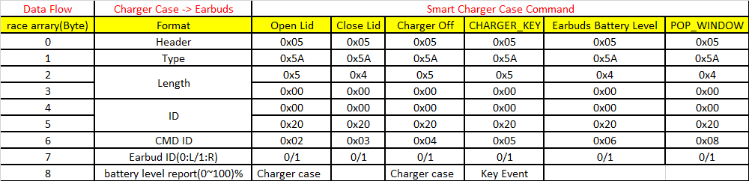
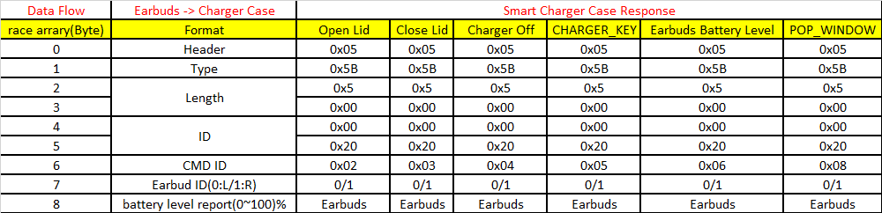
Spec Summaries

Slide 29
One-Wire UART
Smart Charger Case
User Scenarios
Action \ State | Charger Case - Open Lid |  |  |  | Charger Case - Close Lid
 | Earbuds - Inside Charger Case |  | Earbuds - Outside Charger Case |  | Earbuds - Inside Charger Case |  | Earbuds - Outside Charger Case
 | Earbuds - Power On | Earbuds - Power Off | Earbuds - Power On | Earbuds - Power Off | Earbuds - Power On | Earbuds - Power Off | Earbuds - Power On | Earbuds - Power Off
Earbuds - Take Out From Charger Case | V
Earbuds - Put Into Charger Case |  |  | V | Earbuds – Power On
Earbuds - Fully Charged | V |  |  |  | Power-off | V
Charger Case - Lowe Battery | Charger Case Power Off |  |  |  | Power-off | V
Charger Case - Key | V |  |  |  | V | V
Charger Case - LED | V |  |  |  | V | V
 | Verify Pass
 | Verify Fail
 | Not Ready
 | Not Support

Slide 30
Out-of-Case All the time Detection
Earbuds take out from charger case criteria:
  When earbuds get charger out interrupt & VBUS_UART voltage ADC is almost 0V
Communication mode criteria:
  Earbuds get charger out interrupt & VBUS_UART voltage ADC is almost 2.5V
Mode | VBUS_UART | GPIO
CHG mode | 5V (H) | 1.8V (H)
COM mode | 2.5V (L ➔ Charger out interrupt) | 0V (L)
Remove (Out-of-Case) | 0V (Open) (L ➔ Charger out interrupt) | 0V (L)
Notes:
耳機端收到charger out interrupt且讀取到的VBUS_UART電壓ADC接近0V時, 則判定為耳機出倉.
耳機端收到charger out interrupt且讀取到的VBUS_UART電壓ADC接近2.5V時, 則判定為command通訊.

Slide 31
Charger Case Timing Limitation
VBUS_UART
Open-lid
5V
2.5V
0V
(a)
(b)
(g)
(c)
Charger Off
(f)
(e)
Case power off
Charger case: TX
Earbud: RX
Charger case: RX
Earbud: TX
Platform | CHG2COM TX Delay | Interval | Time out | Retry | Power off | Earbud Power on
 | (a)* | (b)* | (c) | (e)** | (f) | (g)
AB1562 | 40ms | 100ms | 40ms | 3 times | N/A | 400ms
AB1565 | 40ms | 100ms | 100ms | 3 times | N/A | 800ms
AB1568 | 250ms | 300ms | 100ms | 3 times | N/A | 800ms
*Depend on plug-in/out debounce time design
**If charger case communicate with IC successfully, Charger case don’t not do any re-try.

Slide 32
Command Policy
Charger case can retry 3 times command if earbuds doesn’t send response(you can set 100ms timeout) or response payload is invalid(wrong payload). Charger case enter error handling if earbuds doesn’t response within three times retry.
DO NOT interrupt the command which is under transmitting.
Command1
Response1
Command1
Response1
Command1
Response1
Error Handling
100ms
100ms
100ms
Command2 interrupts Command1 transmitting
Command1
Command2
Notes:
充電倉送完command後, 若等不到耳機端傳回的response (可設定100ms timeout), 或耳機端傳回的response有錯誤時 (也可以傳unknown command的response), 則充電倉可以嘗試重送3次command, 若3次耳機端都沒有傳回response或response都有錯誤時, 則進入error handling.

Slide 33
One-Wire UART
Smart Charger Case
Charger Case SW architecture
Headset Reference Design
AWSMCE Reference Design
Example Projects
Lid ON/OFF
Earbud into/out of charger case
Earbud full battery detection
Headset Reference Design
AWSMCE Reference Design
Example Projects
Headset Reference Design
AWSMCE Reference Design
Example Projects
Key Event
LED Display
Charger case low battery detection
Application
Headset Reference Design
AWSMCE Reference Design
Example Projects
Customized
Platform
HAL
BSP
GPIO
ADC
Sleep
Timer
UART

Slide 34
One-Wire UART
Smart Charger Case
3rd party MCU SW support plan for charger case.
  SW portable
  * Platform
  @ System Init
  @ Vector
  @ Interrupt Handler
  * HAL
  @ Peripheral Driver
  SW support
  * Reference code
  * API document
  * Wrap for HW architecture differences
  * Customized application

Slide 35
Charger case Design flow
Open cover
VBUS_UART
5V turn on
Idle
Open cover to
Open-lid Command need 800ms(for ab155x)/400ms(for ab156x)
Open-lid Command
NV key define agent/client
All state need to check if case low battery( less 10%)
Close cover
Close cover to Close-lid Command
need 3s
Yes
Close-lid Command
Check lid open or case low bat then charging in
Detect charging current < 5 mA
Delay 3 sec. to send Charger-off command
Charger-off Command
VBUS 5V turn off (*)

Slide 36
Charger Case Design Guidance
Open-lid command sending delay requirement:
  Open-lid during charger on: 0ms
  Open-lid during charger off: 800ms(for ab155x/ab1565/ab1568) / 400ms(for ab1562) min delay time for earbuds initialization
Close-lid command sending delay: 3 second for de-bouncing
Command resending:
To avoid earbuds miss commands, the charger case should always resend command 3 times by the command-response mechanism.
Payload of ‘Charger case key’ is defined as key value. ‘0’: long press 3 second to disconnect w/ handset, ‘1’: long press 10 second to clear pairing data w/ handset. Others: reserved for future use.
Payload of ‘Open lid’ & ‘Charger off’ is defined as ‘Battery level report’. Charger case battery level=battery level report percent.
If MCU need to resend command, MCU need to enter Com mode again. Re-enter Com mode means you need enter changer mode first and then enter to Com mode.
MCU need cut off 5V after MCU send ‘Charger off’ and receive event from IC. After charger off, MCU status as below : provide 5V =>change to Com mode and provide 2.5V =>send ‘charger off’ =>receive event from IC =>cut off 5V and provide 0V.

Slide 37
Summaries and notices
Charger case hardware open lid detect is mandatory(ex: Hall sensor)
Charger case MCU current detect precision should be less than 5 mA. Charger case is based on current detect precision to turn off VBUS_UART(Note: make sure earbuds is fully charged before charger case turn off VBUS_UART)
Charger case hardware VBUS_UART on/off circuit should support discharge feature. Please refer to Airoha hardware reference design
When earbuds is fully charged, you should delay 3 sec and then send charger off command
Charger case is not low battery state and charger case is close lid, send charger off command when earbuds is fully charged
When charger case is low battery state, MCU send charger off command to earbuds and turn off VBUS_UART no matter what earbuds if fully charged or not
When earbuds send charger off command, turn off VBUS_UART and earbuds is power off. When charger case change from close to open lid, charger case should wait 800ms(for ab155x/ab1565/ab1568) / 400ms(for ab1562) before send open lid command
Charger case MCU should wait 3 sec before send close lid command
If user repeat close lid-> open lid -> close lid -> open lid … operation, charger case will make sure previous command is completed and then send next command.(open lid command -> close lid command -> open lid command -> close lid command)
If user repeat open lid and close lid operation, charger case MCU command should mapping to last charger case state(ex: charger case final state is close lid, charger case MCU should last command should send close lid command).
If charger case support key operation, you should separate key press timing. Ex: long press 3 sec for operation 1 and log press 10 sec for operation 2.
Design Notice: Please make sure send charger off command to earbuds when earbuds is fully charged or charger case is low battery. This is most charger case common design error.
Notes:
1). 电池舱需要有开盖检测功能 (ex:透过机构按键,Hall sensor 触发等…).
2). 电池舱内的MCU需要有电流检测功能，作耳机充饱电后断开 Vbus_UART 判断.
电池盒电流检测的精准度要求 < 5mA .
(note:电池舱必须在耳机充饱电后才断开Vbus_UART，以确保耳机充饱电，故电舱设计前需确认耳机端饱电停充电流大小)
3). 电池舱内控制 Vbus_UART (/5V输出)的开关线路，要有discharge功能. (可参阅我方参考线路)
4). 耳机充满电后延后3s才发充满电charger off command.
5). 电池舱电量充足，关盖情况下，耳机充饱电后，电池舱发送charger off command;
开盖状态下，耳机充饱电，电池舱不执行charger off command.
6). 电池舱低电状态，不管耳机有无充饱与否，MCU皆发送charger off command给耳机，并关闭电池舱Vbus_UART供电.
7). Charger off state完，耳机关机，断开Vbus_UART后，开盖，需要等800ms才发Open Lid command；
耳机若还未充饱电，Vbus_UART未断开前即开盖，则Open lid command则可立马发送.
8). 关盖后，MCU等 3sec.才发Close lid command.
9).若有连续发送不同command操作情况(如反复开关盖)，command发送过程中，如果触发到另一个command，
第一个command要完整发送后，才再送另一个command.
10).连续性重复开关盖，MCU要能发送最后一次盖子状态的相应command.
11).若电池舱有利用按键事件触发不同command发送，建议电池舱的按键行为要有明显的差异，以作区别.
如一为长按3s，另一则为长按10s.
注意! 上述注意事项均为电池舱设计要领，需要留意，其中又以耳机电池充饱电后及电池舱低电情况未送Charger off
command为最常见错误.

Slide 38
Confidential B

